Slide 1
Chapter 51

Slide 2
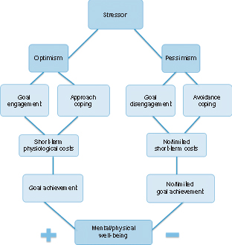
Figure 1 Optimism, pessimism, and stress. The stress management model displayed by dispositional optimists is based on positive outcome expectancies, goal engagement, and approach coping strategies, may entail short-term physiological costs, but is associated with goal achievement and positive mental and/or physical well-being.
Illustrated by Trude Nordby Bøe.

